Slide 1
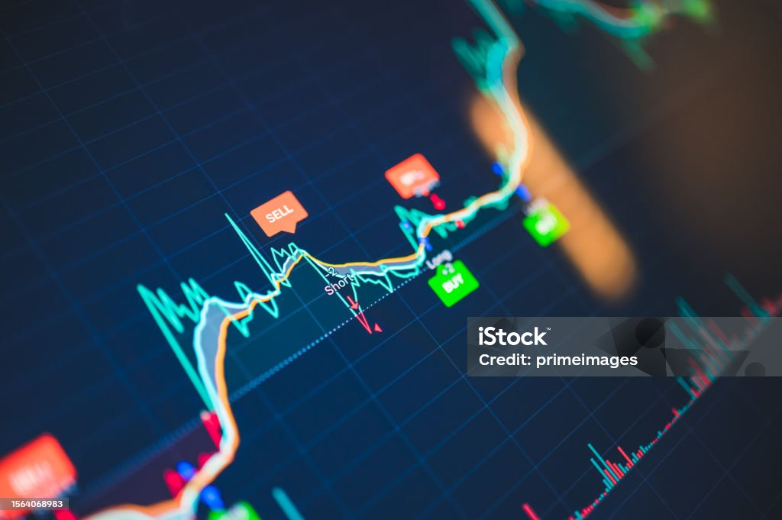

Real-Time Algorithmic Trading Using Predictive Sentiment Data for Cryptocurrencies
Christopher De Leon
Victor Andujar
Russell Gould

Slide 2
Executive Summary
Algorithmic trading using predictive sentiment analysis is a key strategy for cryptocurrencies. To aid decision making, insights are extracted from news and social media using natural language processing and machine learning. Crypto market dynamics and susceptibility to rapid fluctuations make it an ideal candidate for this strategy, offering benefits like timely decisions, and risk mitigation. The future is promising, with ongoing advancements in machine learning expected to yield more sophisticated tools for precise algorithmic trading with predictive sentiment analysis for Crypto.
“Gauging market sentiment became crucial with the proliferation of social media and online forums. This evolution led to sentiment analysis tools becoming a cornerstone of crypto trading strategies” - https://medium.com/@ByTrade.io/understanding-the-role-of-sentiment-analysis-in-crypto-futures-trading-2ffe3ec7d658

Slide 3
Key Objectives
Identify data sets that could be used for detailed sentiment analysis across multiple social platforms.
Develop an algorithmic trading model based on predictive sentiment analysis and supervised machine learning methodologies
Implement buy/sell signal on real-time trading platform and complete 24hrs of practice trading.

Slide 4
Key Research Questions
Our research (feasibility) questions are as follows:
Does a neural network or a svm model perform better for stock market predictions?
How can we fully automate this process, with very little user intervention?
Can we gather sentiment data, live and hourly to make this work?
Will PCA help NN's or SVM models perform better?

Slide 5
Breakdown of tasks and roles
System Design & Architecture: To be led by Christopher, outlining the main components of the trading system and how they will interact.
Algorithm Development: Chris and Russell will collaborate to design, test and optimize our trading algorithms using tensorflow and Backtrader.
Interface Design: Victor will take the helm in designing a sleek, intuitive, and interactive interface using Plotty Express, ensuring the system is user-friendly and efficient.
Data Management: Victor and Russell: data sourcing, formatting and data management.
Integration & Testing: The team will collaborate in this final phase to integrate all system components, followed by rigorous testing to ensure optimal performance.

Slide 6
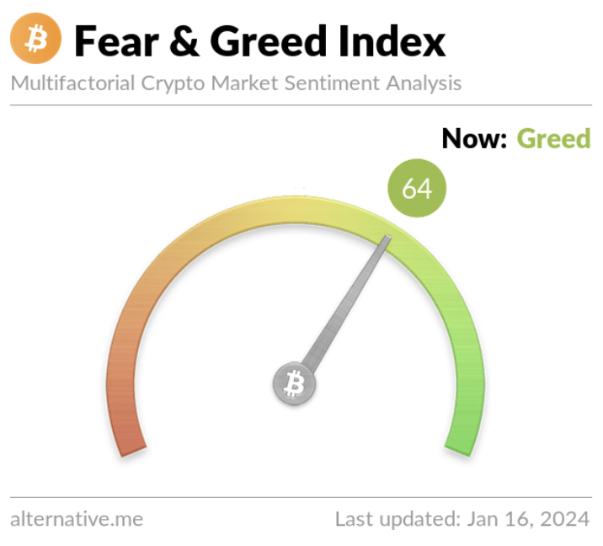

Datasets
1 - Kaggle/Alternative.Me
2- Augmento.AI
2016-02-01 to 2023-03-31 (6 years)
Daily fear/greed index for Crypto
2016-11-01 to 2023-12-21 (8 years)
Hourly crypto sentiment
62,500 rows x 280 columns
93 categories of intensity data

Slide 7
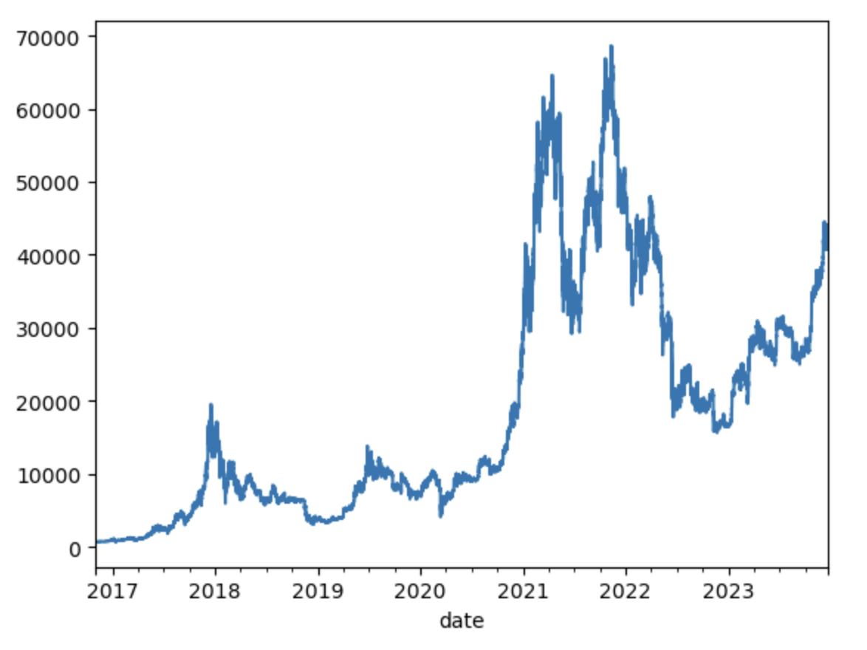
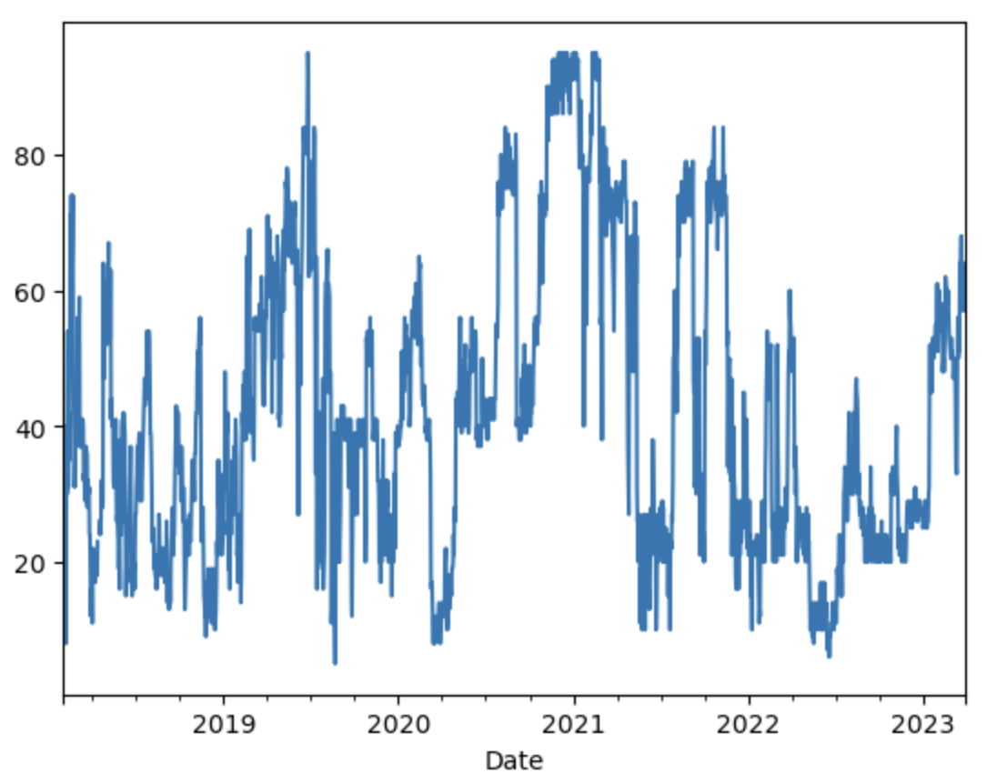
Kaggle/Alternative.Me
BTC
Closing Price
2016-02-01 to 2023-03-31
Daily fear/greed index for Crypto
Crypto Fear/Greed Index (0-100)
https://www.kaggle.com/datasets/adilbhatti/bitcoin-and-fear-and-greed

Slide 8
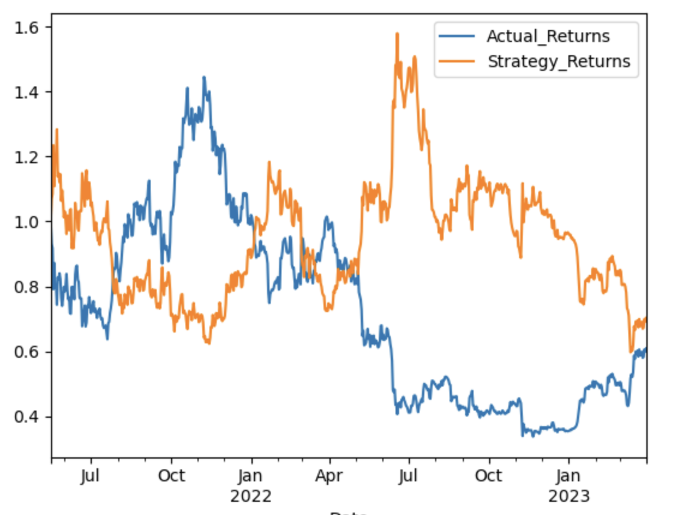
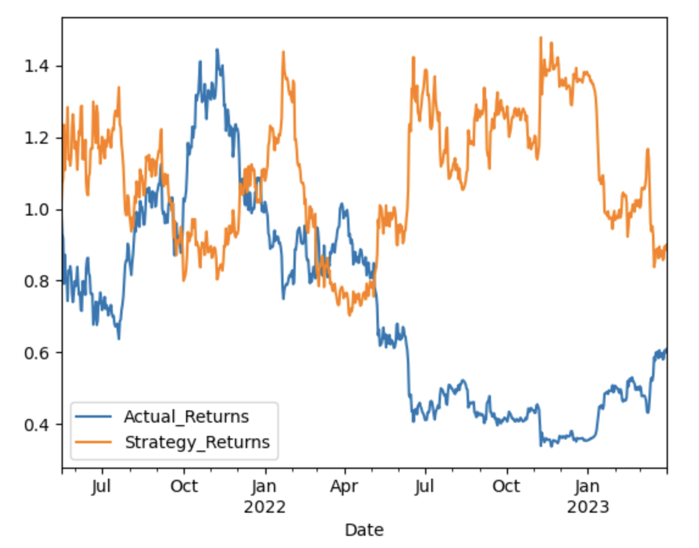
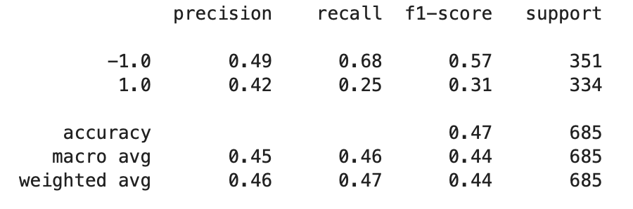
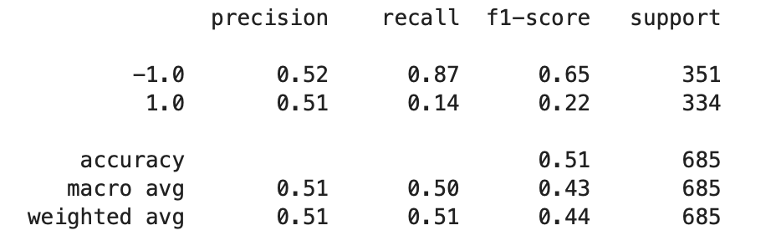
Comparing LR vs. SVM (36 months training, 18 months pred)
Bitcoin
Bitcoin
Logistic Regression
SVM
Prediction Classification Reports

Slide 9
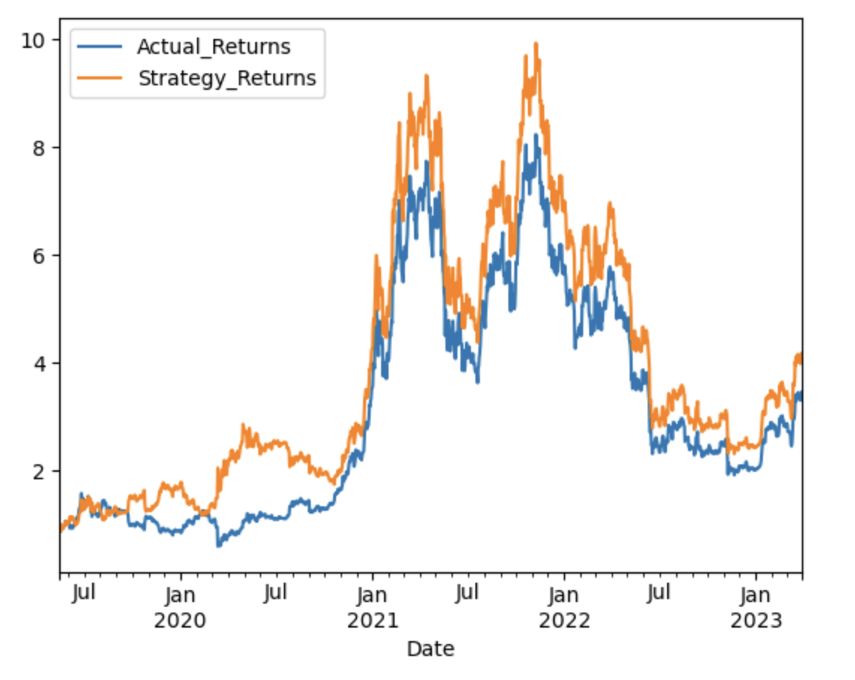
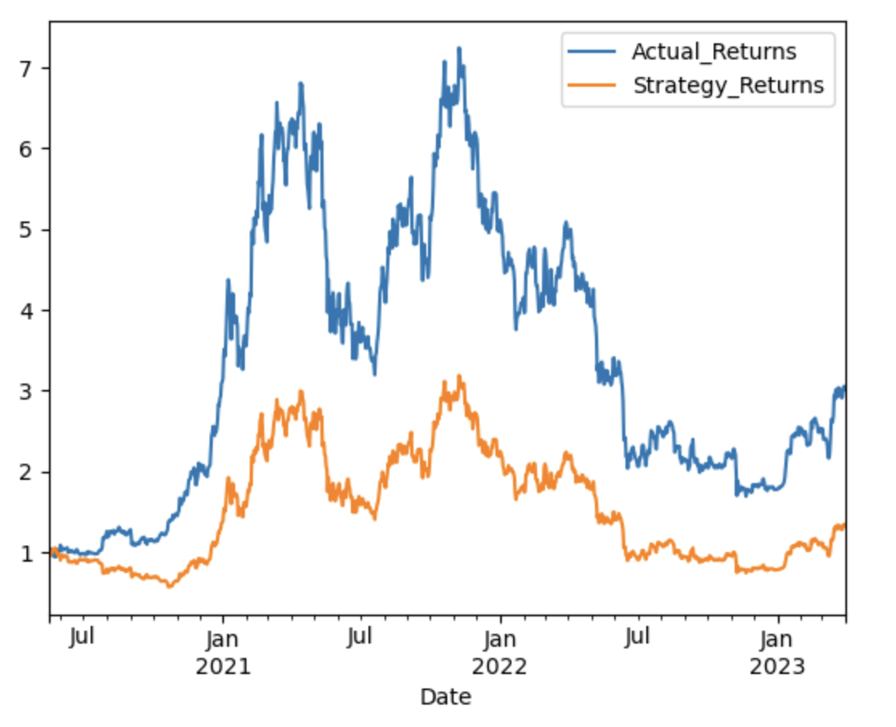
Kaggle Data (12, 24, 36 months of training)
0
12 Months
60 Months
0
24 Months
60 months
0
36 Months
60 Months
Train
Predict
Train
Predict
Train
Predict

Slide 10
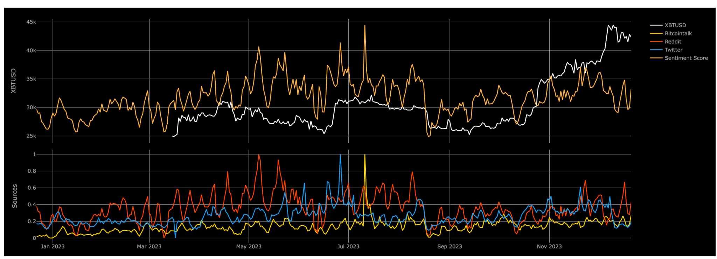
Augmento.AI
Augmento is ingesting crypto related posts from Twitter, Reddit and Bitcointalk and turning the social sentiment of these posts into data.
Augmento’s AI is trained exclusively on cryptoasset- and trading-related language and uses a hybrid approach (machine learning and linguistic analysis) to ensure the highest achievable accuracy. While conventional sentiment analysis can merely differentiate between positive and negative sentiments, Augmento’s AI can recognize and quantify the entire spectrum of crypto crowd psychology.

Slide 11
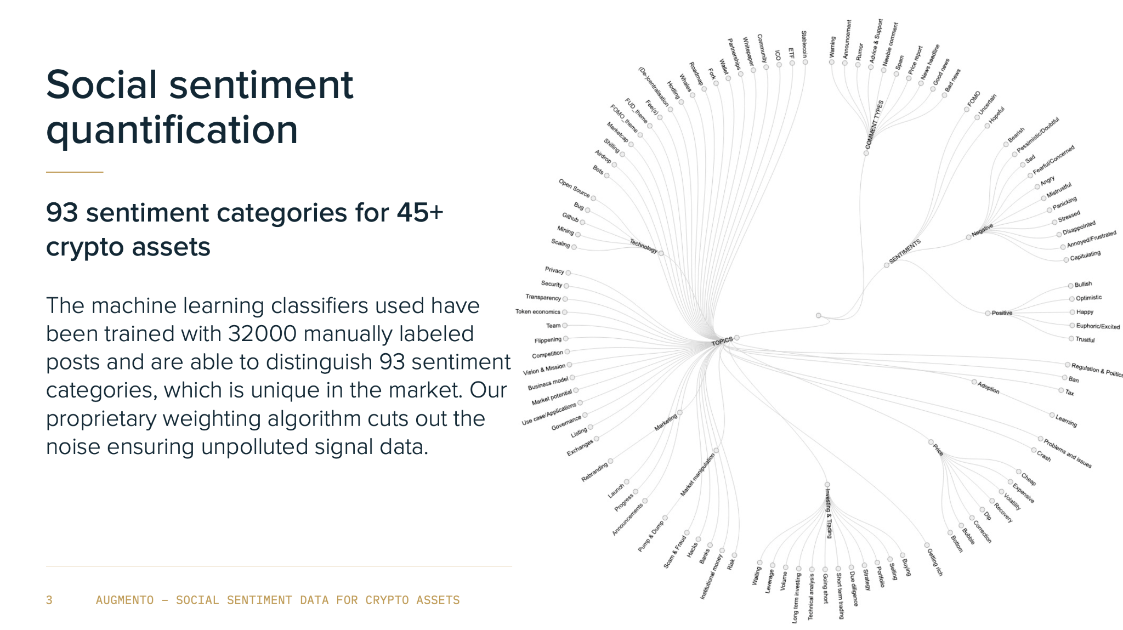

Slide 12
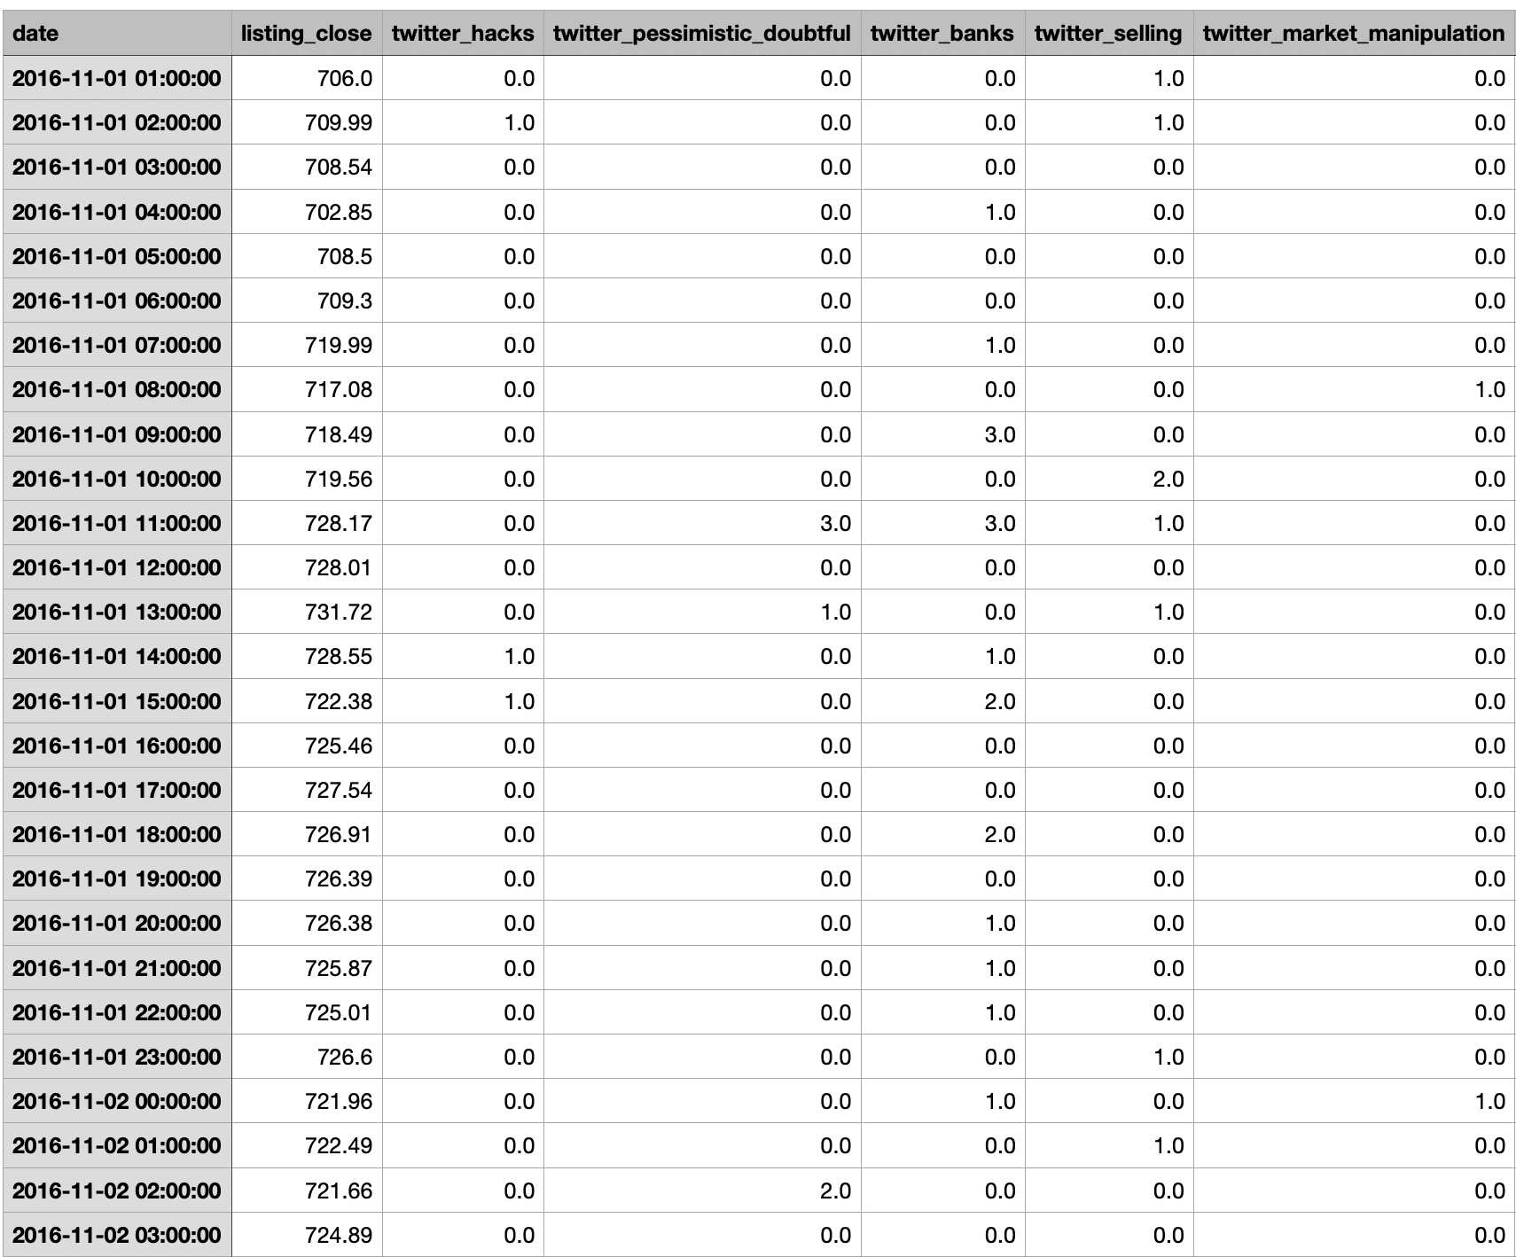
Augmento.AI
Raw hourly data from Augmento
Hourly API
93 major categories (280 features)

Slide 13
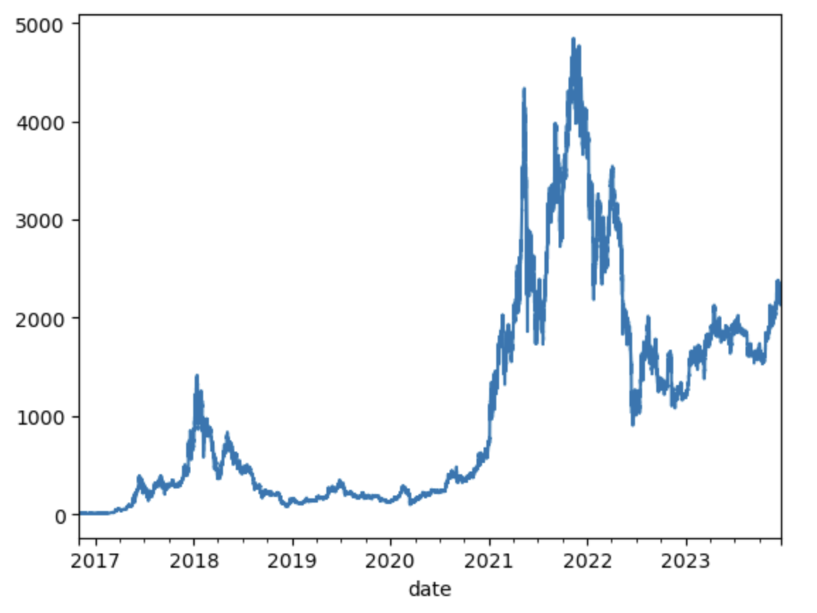
Ethereum
~80%
Training
Prediction
Training on 6 years of data and predicting the last 1 year
Compare neural net and svm classification models
Provide feasibility assessment on prediction model effectiveness

Slide 14
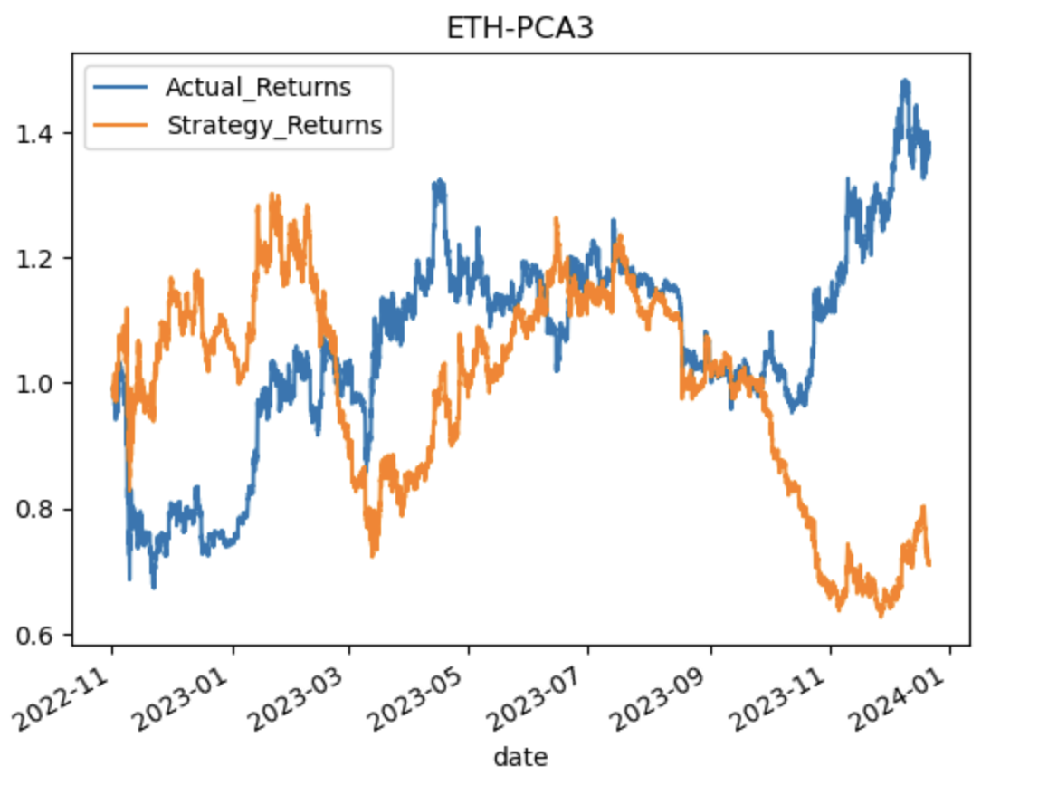
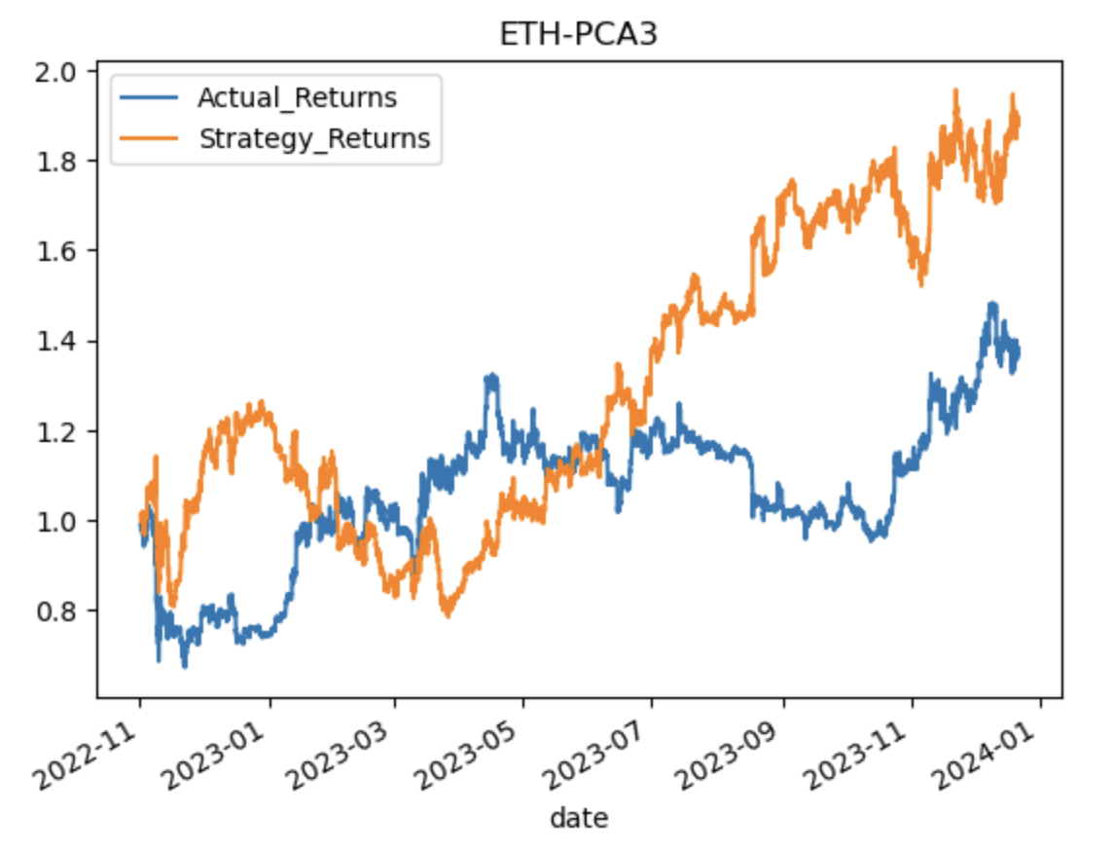
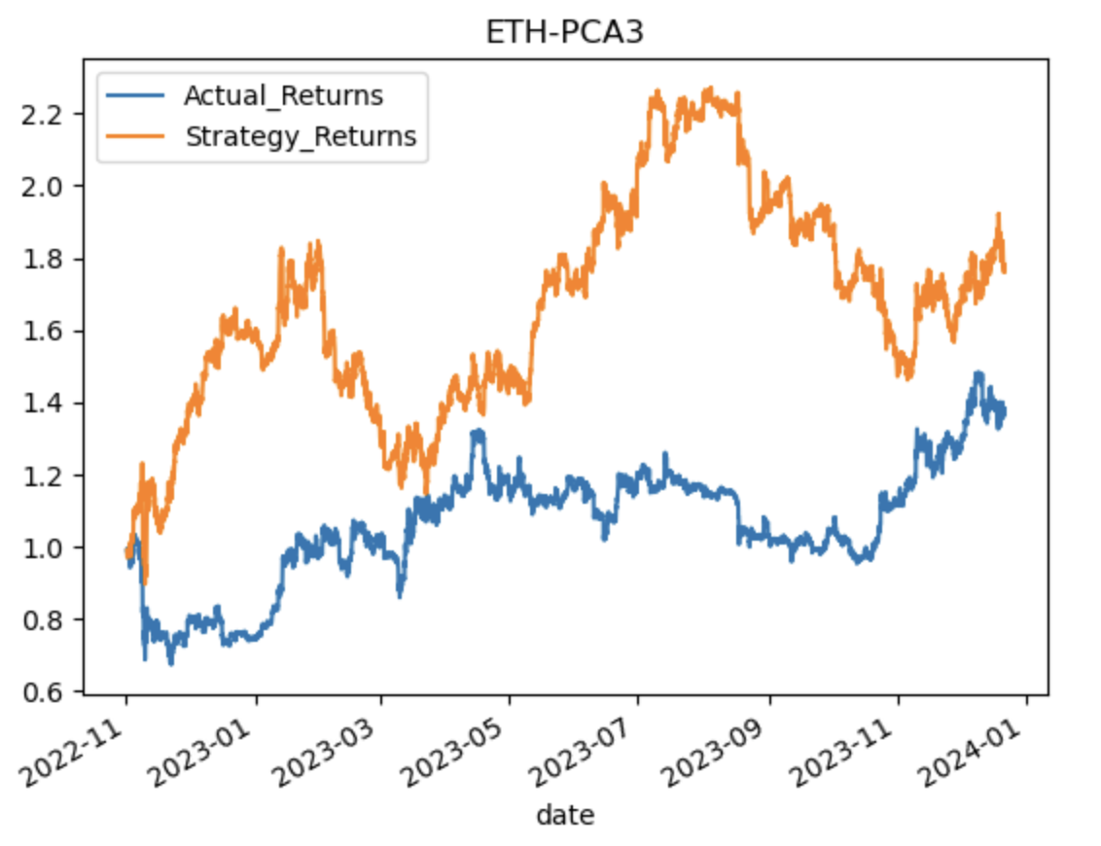
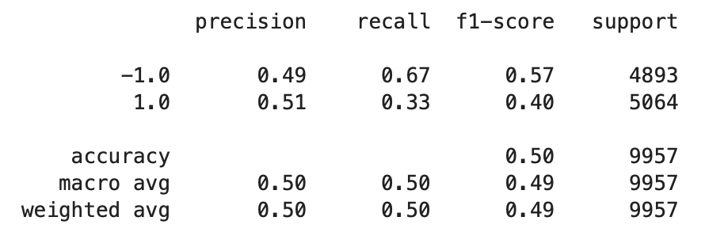
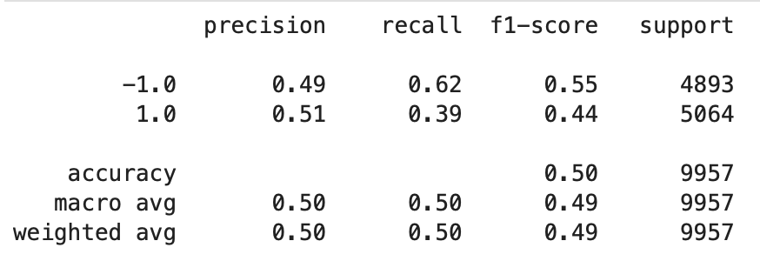
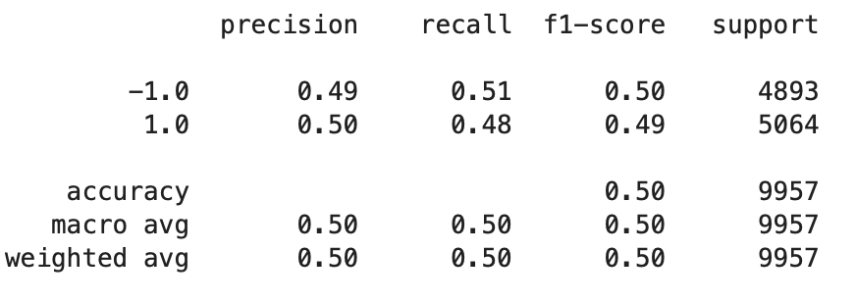
Ethereum - PCA analysis with 7 year training + 1 year pred
PC1 - 0.1438543 , PC2 0.08886031, PC3 0.02602236])
PC1 0.143 , PC2 0.088, PC3 0.026, PC4 0.0162, PC5 0.014, PC6 0.010)
PC1 0.143 , PC2 0.088, PC3 0.026, PC4 0.0162, PC5 0.014, PC6 0.010, PC7 0.008, PC8 0.008, PC9 0.007

Slide 15
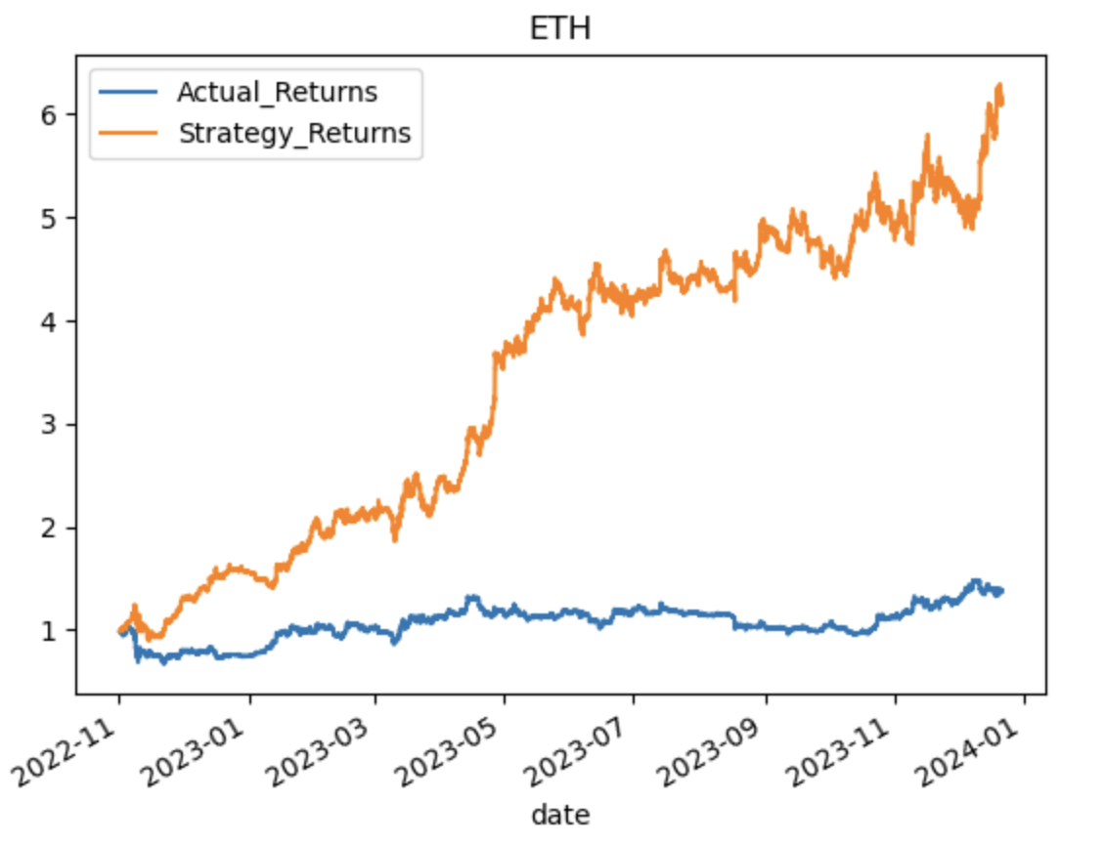
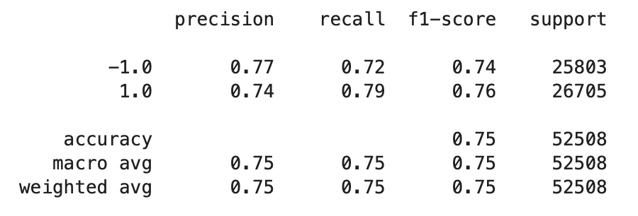
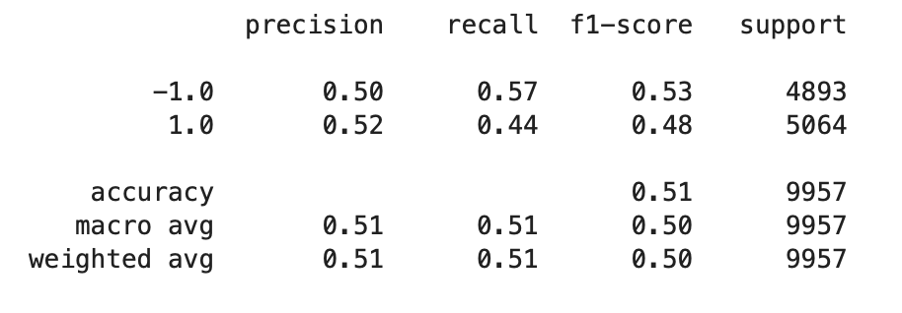
Ethereum - 72 months of hourly training (12 month prediction)
SVM
Training Data
Test Data

Slide 16
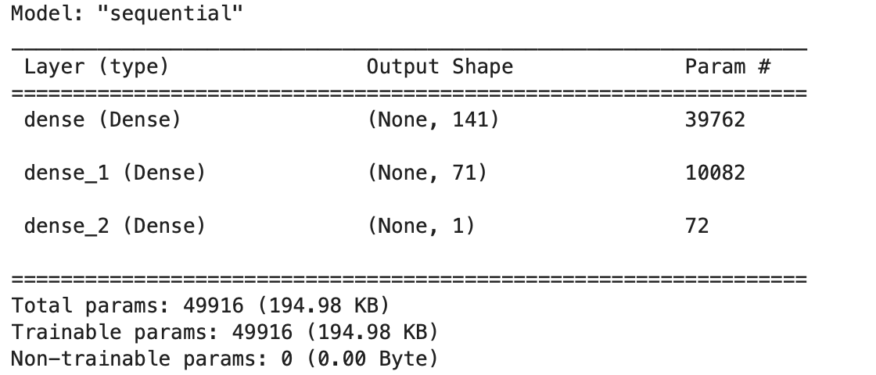
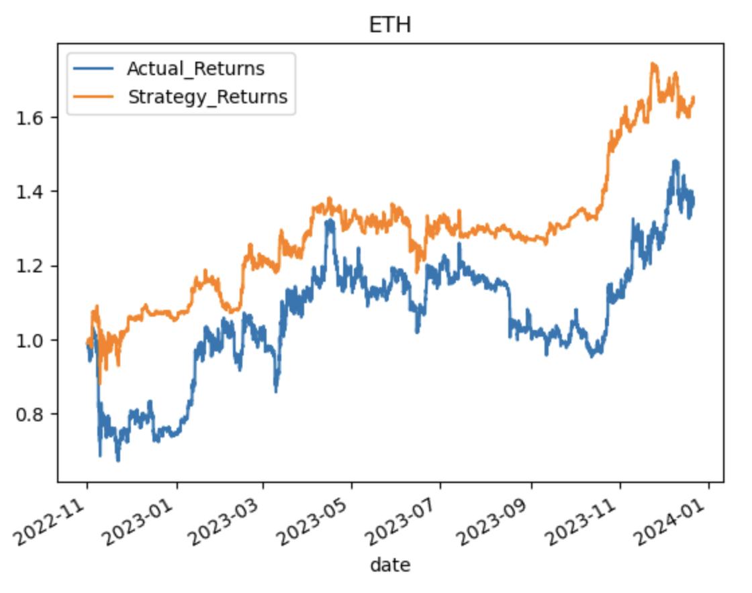
Ethereum - 72 months of hourly training (12 month prediction)
Neural Net

Slide 17
Summary
SVM seemed to be the most effective ML algorithm.
Training and testing periods can skew prediction models great (needs optimized).
PCA was not very effectively given the large heterogeneity of data.
Potential feasibility using Augmento AI sentiment data as a predictor for hourly crypto trading

Slide 18
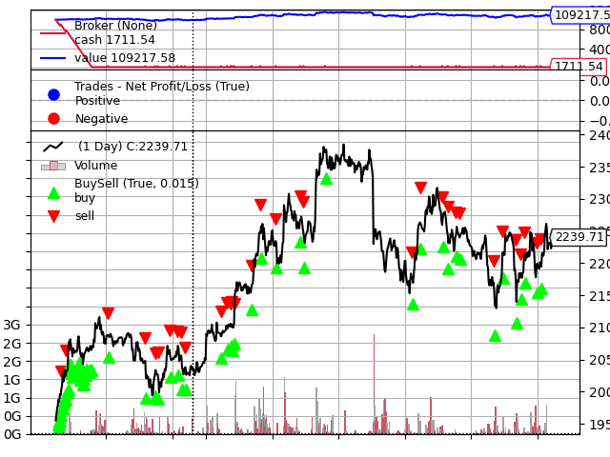
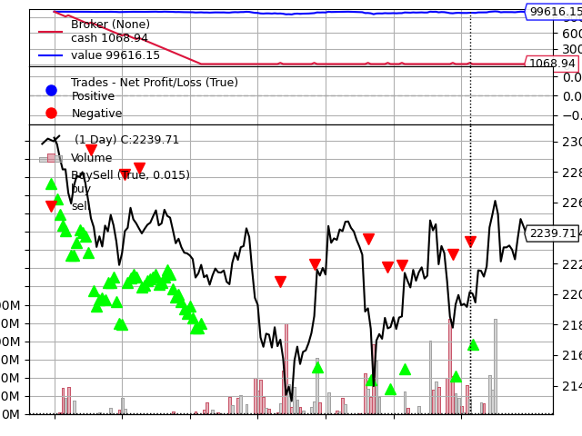
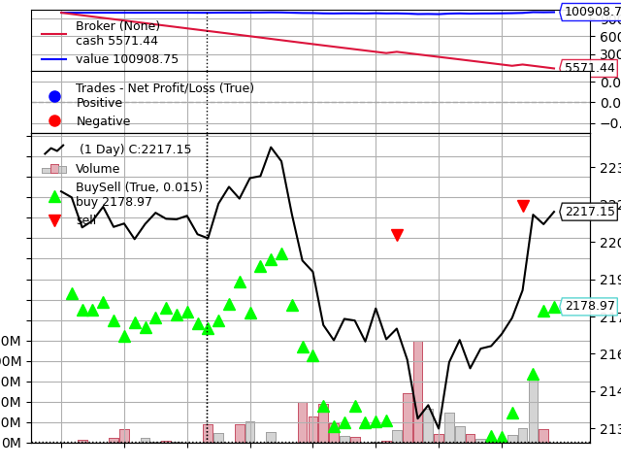
ETH Backtest with Augmento AI sentiment data, SVM Model
1 Month 1 Week 3 Days
$9217.58 profit $-383.85 loss $908.75 profit

Slide 19
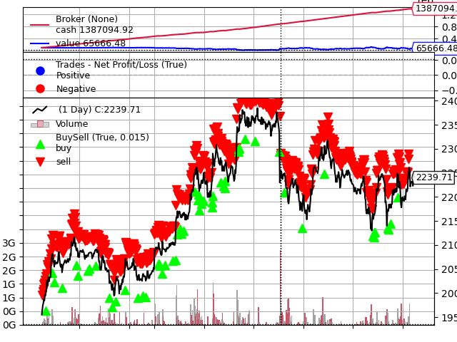
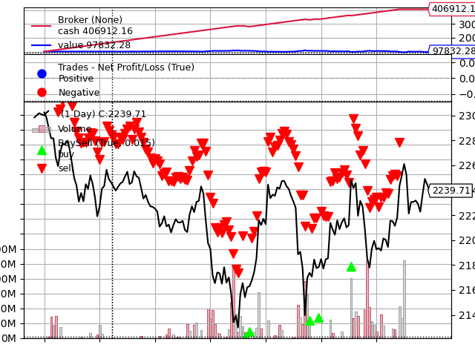
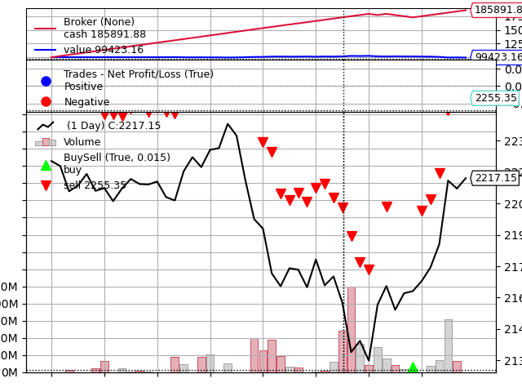
ETH Backtest with Augmento AI sentiment data using dimensionality reduction method (PCA), SVM Model
1 Month 1 Week 3 Days
$-34333.52 loss $-2167.72 loss $-576.84 lss

Slide 20
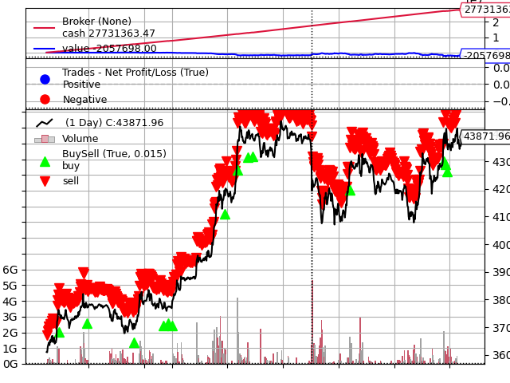
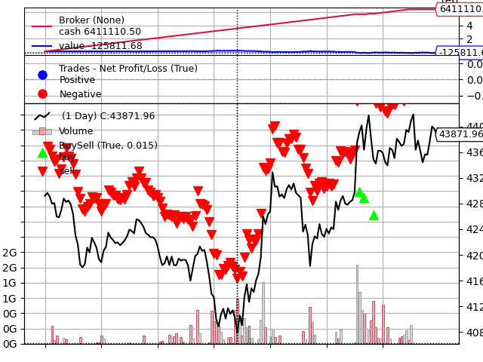
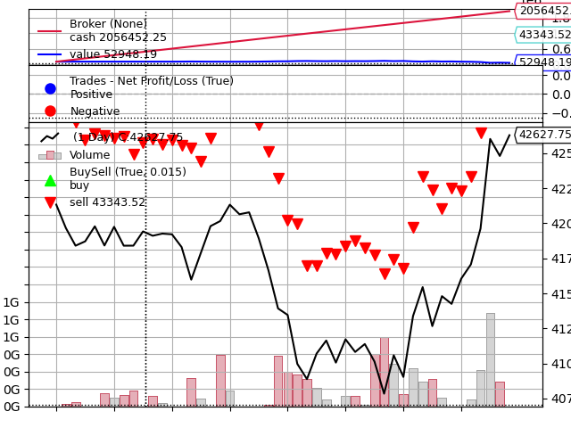
BTC Backtest with Augmento AI sentiment data, SVM Model
1 Month 1 Week 3 Days
$-2157698.00 loss $-225811.68 loss $-47051.81 loss

Slide 21
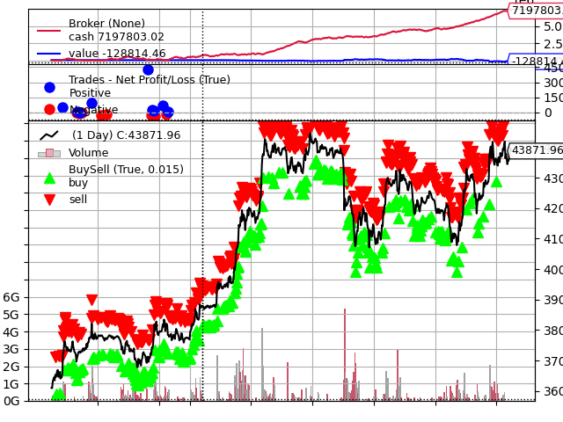
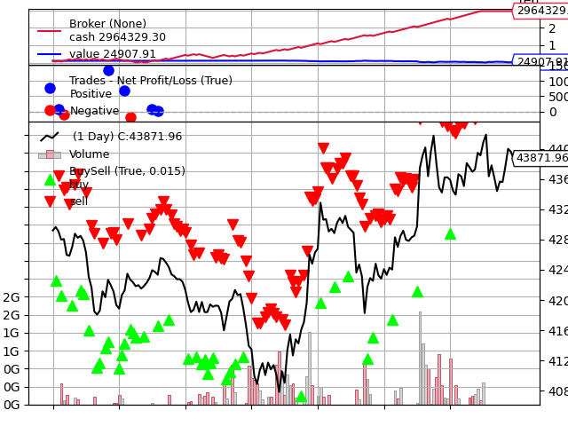
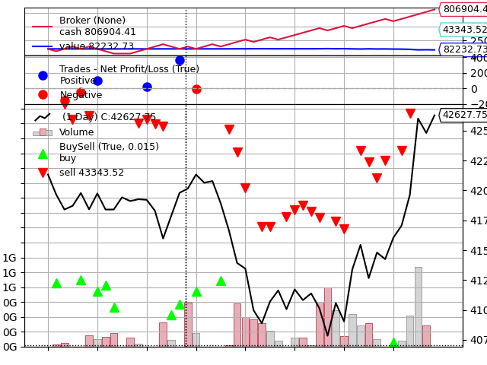
BTC Backtest with Augmento AI sentiment data using PCA, SVM Model
1 Month 1 Week 3 Days
$-228814.46 loss $-75092.09 loss $-17767.27 loss

Slide 22
E2E Alpaca Trading Demo
Live demo demonstrating how straightforward a predictions dataframe can be feed into Alpaca for real time trading

Slide 23
Links
Deployed application.
GitHub repo.
https://github.com/Chrisdeleon91/Algorithmic-Trading-Project-2

Slide 24
Discussion and Next Steps
Apply to smaller crypto stocks.
Continue exploring specialised crypto forums offer a wealth of sentiment data.
Incorporate other news and media monitoring.
Take into consideration other market data and technical indicators.

Slide 25
Supplement

Slide 26
Tasks in detail
Data Cleaning and Formatting - We will use Pandas to clean and format the cryptocurrency dataset. This will involve removing any errors in the data, converting the data to the correct format and creating any new columns that are needed.
Algorithm Development - We will use a machine learning model to create our predictions and implement our algorithm using the predicted buy and sell signals. We hope with machine learning it can develop a trading strategy that can identify and exploit profitable trading opportunities in the cryptocurrency market.
Visualization - We will use Plotty Express and backtrader to visualize our data. These visualizations will help us to understand the data and to identify any potential trading opportunities.
Integration - We will use backtrader to integrate the algorithms and visualizations required.
Paper Trading - Once we are satisfied with the performance of our system in backtesting, we will deploy it to a paper trading account. This will allow us to test our system in real-world market conditions without risking any real money.

Slide 27
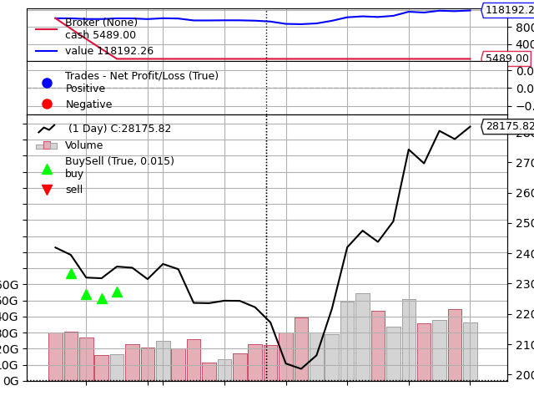
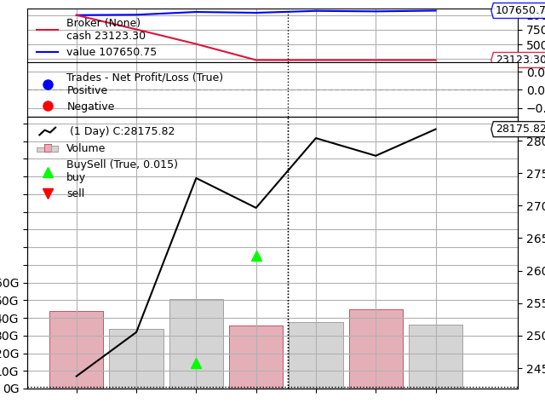
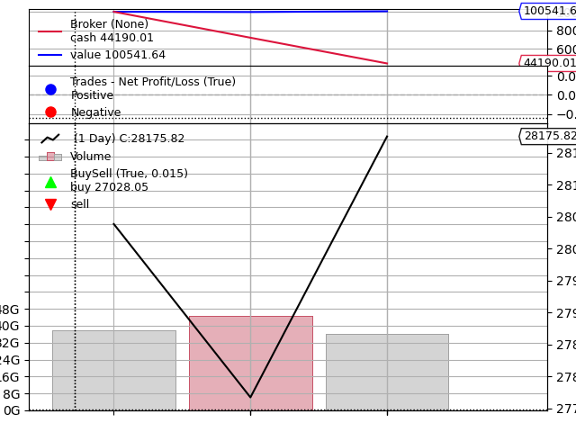
BTC Backtest with Fear and Greed Index data
1 Month 1 Week 3 Days
$20293.53 profit $1123.76 profit $-316.58 loss

Slide 28
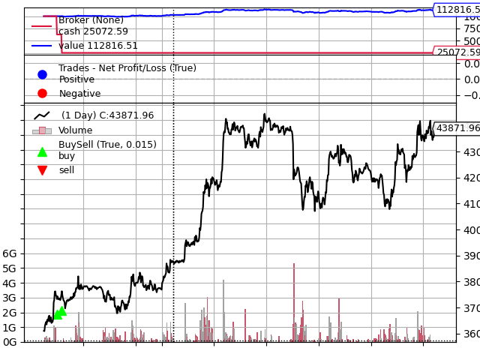
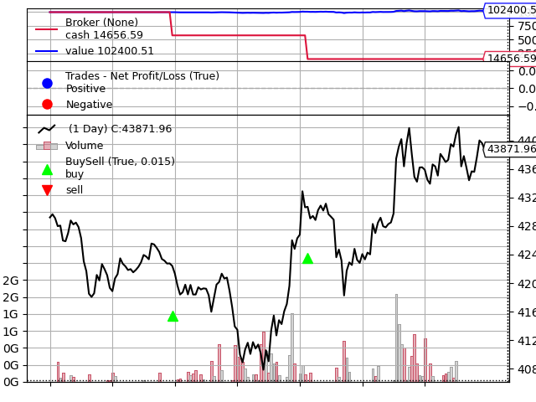
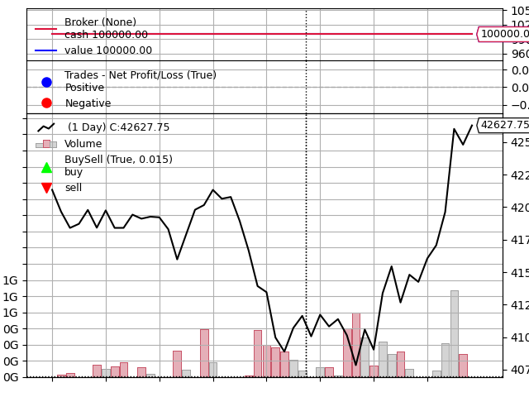
BTC Backtest with Augmento AI sentiment data using a Neural Network
1 Month 1 Week 3 Days
$12816.51 profit $2735.38 profit $956.67 profit

Slide 29
Data Techniques and E2E algorithmic trading
Description and reasoning of data source.
Kaggle, Yahoo Finance, Augmento.Ai
API calls and csv, collection, exploration and cleaning.
SVM machine learning, One Hot Encoder, PCA, backtesting strategies
Alpaca real-time trading w/ paper money
E2E API data extraction, data cleaning, dataframe preparation, machine learning workflows, and alpaca paper trading (develop the process)

Slide 30
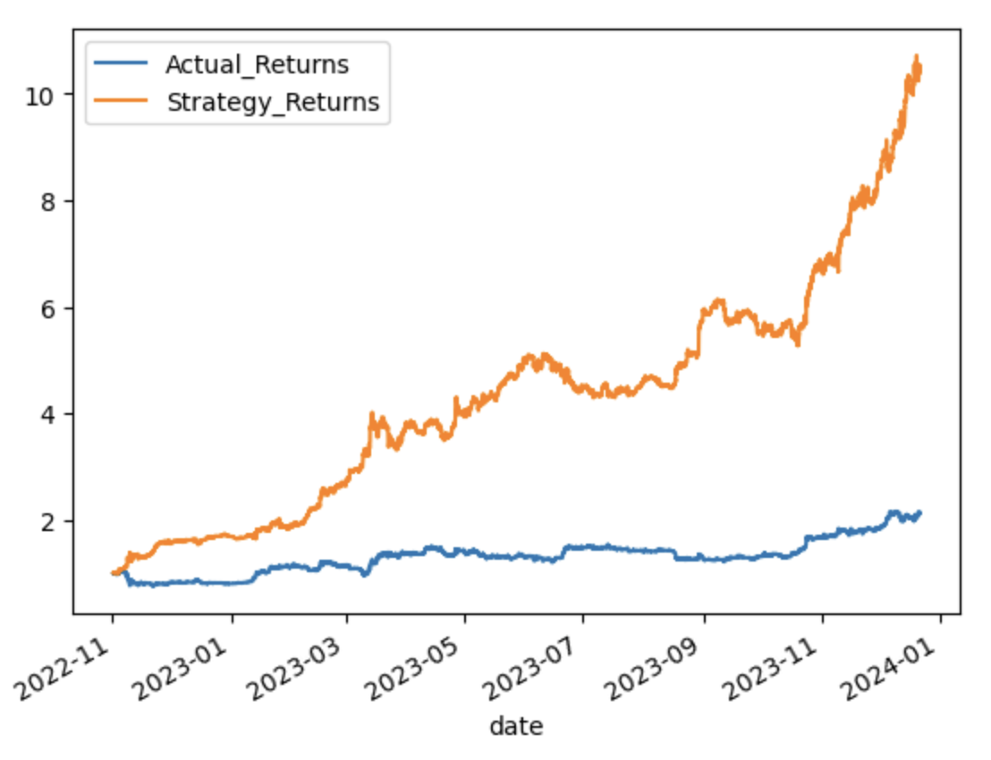
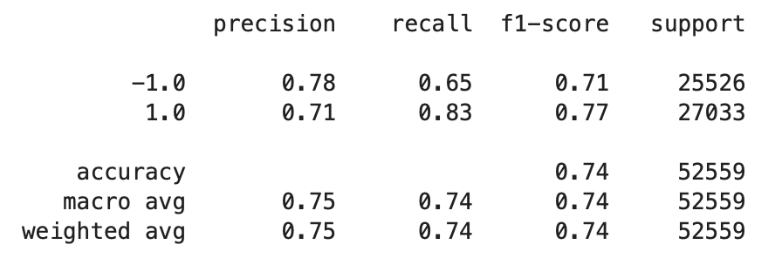
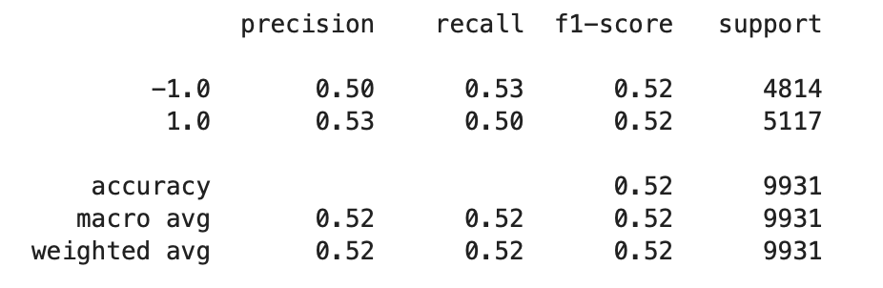
BITCOIN - 72 months of hourly training (12 month prediction)
SVM
Training Data
Test Data

Slide 31
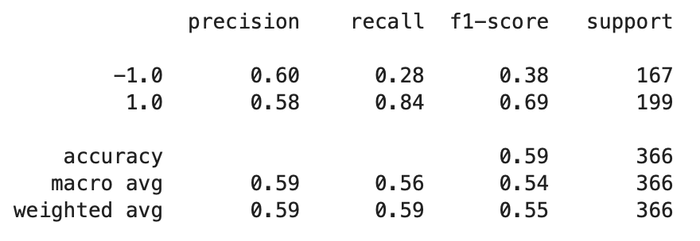
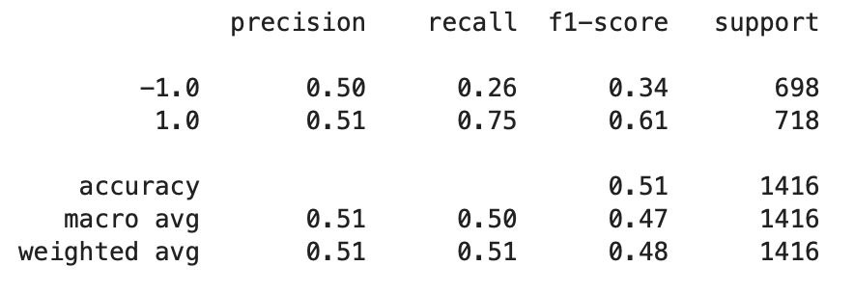
Kaggle Data (12 months training, ~48 months test)
Training Data
Test Data

Slide 32
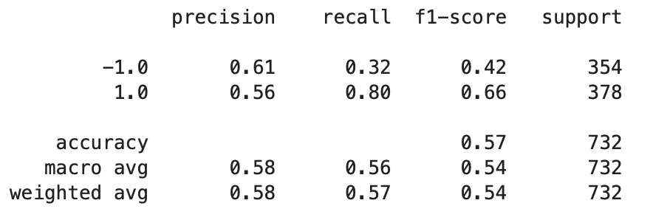
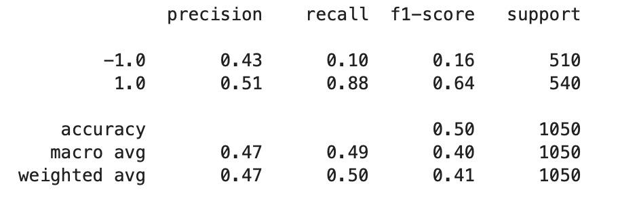
Kaggle Data (24 months training, ~36 months test)
Training Data
Test Data

Slide 33

Kaggle Data (36 months training, ~18 months test)
Training Data
Test Data

Slide 34



Kaggle Data (48 months training, ~12 months test)
Training Data
Test Data

